Slide 1
Data Warehousing and OLAP Technology

Slide 6
OLAP
OLAP stands for On-Line Analytical Processing.
An OLAP cube is a data structure that allows fast analysis of data.
OLAP tools were developed to solve multi-dimensional data analysis which stores their data in a special multi-dimensional format (data cube) with no updating facility.
An OLAP toll doesn’t learn, it creates no new knowledge and they can’t reach new solutions.
Information of multi-dimension nature can’t be easily analyzed when the table has the standard 2-D representation.
A table with n- independent attributes can be seen as an n-dimensional space.
It is required to explore the relationships between several dimensions and standard relational databases are not very good for this.

Slide 7
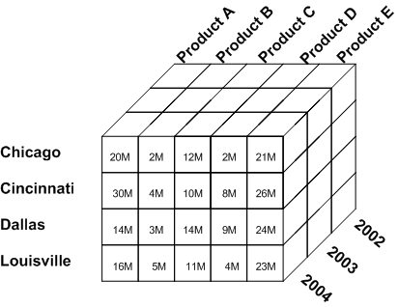
OLAP Tool

Slide 8
OLAP Operations
Slicing: A slice is a subset of multi-dimensional array corresponding to a single value for one or more members of the dimensions. Eg: Product A sales.
Dicing: Dicing operation is the slice on more than two dimensions of data cube. (More than two consecutive slice). Eg: Product A sales in 2004.
Drill-Down: Drill-down is specific analytical technique where the user navigates among levels of data ranging from the most summarized to the most detailed i.e. it navigates from less detailed data to more detailed data. Eg: Product A sales in Chicago in 2004.

Slide 9
OLAP Operations
Roll-Up: Computing of all the data relationship for more than one or more dimensions i.e. summarization of data to one o more dimensions. Eg: Total Product.
Pivoting: Pivoting is also called rotate operation. It rotates the data in order to provide an alternative presentation of data.

Slide 10
OLTP
OLTP stands for Online Transaction Processing
Used to carry out day to day business functions such as ERP (Enterprise Resource Planning), CRM ( Customer Relationship Planning)
OLTP system solved a critical business problem of automating daily business functions and running real time report and analysis.

Slide 11
OLAP Vs OLTP
Facts | OLTP | OLAP
Source of Data | Operational Data | Data warehouse (From various database)
Purpose of data | Control and run fundamental business tasks | For planning, problem solving and decision support
Queries | Simple queries | Complex queries and algorithms
Processing Speed | Typically very fast | Depends on data size, techniques and algorithms
Space requirements | Can be relatively small | Larger due to aggregated databases
Database Design | Highly Normalized with many tables. | Typically denormalized with fewer tables. Use of star or snowflake schema.

Slide 12
Similarity and Dissimilarity
Similarity
Numerical measure of how alike two data objects are.
Is higher when objects are more alike.
Often falls in the range [0,1]
Dissimilarity
Numerical measure of how different are two data objects
Lower when objects are more alike
Minimum dissimilarity is often 0
Upper limit varies

